Slide 1

The role of foreign workers in a segmented labour market, the case of Italian Agriculture and Fisheries
Maria Carmela Macrì – Lucia Tudini
CREA Politiche e Bioeconomia
Zollikofen, 7- 10 July 2026
3rd International Symposium on Work in Agriculture – ISWA
Addressing current and future challenges of work in agriculture: research, policy and practice

Slide 2
Outline
Employment in primary sector
Foreign workforce
  in agriculture
  in fisheries
  Common needs and common types of actions

Slide 3
Employment in Agriculture, forestry and fisheries
In 2025
Residents with non-Italian citizenship account for 9.1% of the population.
Foreign workers account for 10.7% of the economy as a whole.
Source: Istat, Labour Force Survey

Slide 4
Employment in agriculture
 | Number of people |  |  | Days worked per person
 | 2020 | % | Var % 2020/2010 | 2020 | 2010
Family labour | 1,459,588 | 53.0 | -50.2% | 99.7 | 69.0
Non-family labour | 1,295,753 | 47.0 | 38% | 53.0 | 53.0
Total labour | 2,755,341 | 100.0 | -28.8% | 77.7 | 65.0
In 2010, family labour accounted for 2 out of 3 people; in 2020, slightly more than 1 out of 2
Source: Istat – Agricultural Census 2010 and 2020
On average, an agricultural worker's income per week worked is 77% of the average income
22 weeks worked, compared with an average of 43 (in 2014, the figures were 18 and 43)
Source: INPS, Observatory on Employees and Self-Employed Workers

Slide 5
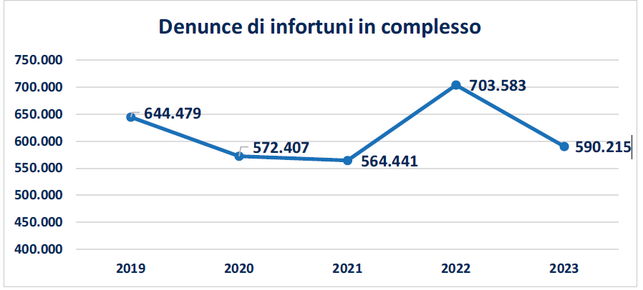
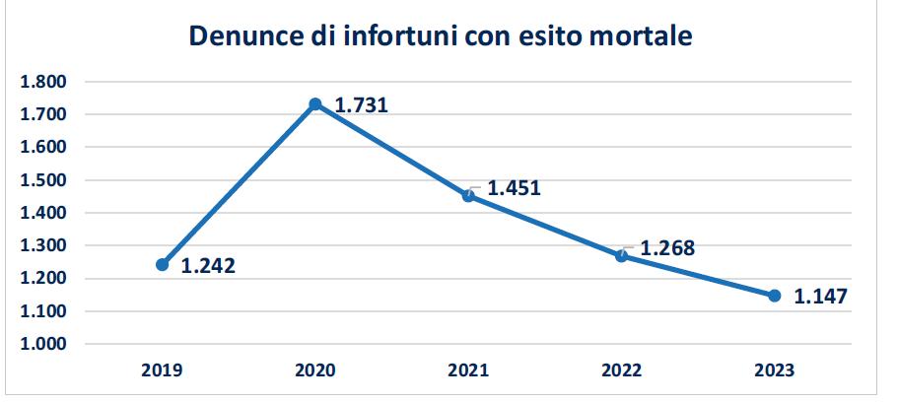
Economic security and physical safety
Specifically, 31.3% of paid agricultural workers in 2023 (compared to 9.2% across the total economy)
ISTAT: National accounts
Total injury reports
Employed persons in agriculture in 2023: 3.6%
Fatal injury reports
4.5% agriculture
11.6% agriculture
Source: INAIL, 2023 Annual Report

Slide 6




Survey on Foreign Workers in Agriculture by CREA
Since the 1990s, INEA — now CREA — has conducted a survey on the presence of foreign workers
Biennial frequency
METHODOLOGY
Starting from the analysis of quantitative information from the sources:
ISTAT Agricultural Census, Labour Force Survey, national accounts
INPS observatories: foreign citizens, agriculture, employees and self-employed workers
Interviews complete and clarify the evidence, also to identify policy suggestions for improving the social sustainability of Italian agriculture
There is a severe lack of data and information regarding fisheries

Slide 7
Employed mostly in...
Source: ISTAT, 7th Agricultural Census

Slide 8
Fewer from the European Union, more from third countries
Notably, there were fewer people from Romania (39% fewer than in 2018). There were significant increases from India (+48%), Pakistan (+100%) and Bangladesh (+200%).
Source: INPS - Observatory on Foreign Citizens by Status
Source: INPS – Observatory on Agricultural sector

Slide 9
What type of labour demand in agriculture is met by foreign labour?
OECD identifies two types of labour shortage:
for more physically demanding, discontinuous and low-paid jobs, where migrant workers are increasingly employed
for skilled jobs, which are needed in highly technologically advanced and digitalised agriculture that intends to become more sustainable by reducing water consumption and chemical inputs.
OECD, 2023, Labour and Skills Shortages in the Agro-Food Sector

Slide 10
The vicious circle
More-qualified workers prefer better conditions elsewhere
The farm offers unattractive, seasonal and low-paid wage work
Skills are lacking to adopt innovations that improve competitiveness and sustainability
The farm does not grow in a sustainable and competitive manner

Slide 11
Activate a different circle
Promote training and technological and organizational innovations, foster cooperation and horizontal integration
higher human capital, more skills to adopt innovation
higher farm margins higher resources for investments
Higher demand for qualified and well paid labour

Slide 12
Fisheries labour is contracting faster in Italy
Employment and work intensity are falling, turning crew supply into a structural pressure.
EU fishing fleet
Italian fleet
119k
74k
20,745
13,367
engaged crew
in 2023
full-time equivalent
work in 2023
engaged crew
in 2023
FTE work
in 2023
2014–2023 trend
Engaged crew: −15%
FTE work volume: −30%
Faster contraction than the EU average
Engaged crew: −23%
FTE work volume: −35%
Executive takeaway
The decline is not only a loss of headcount: it also signals less continuity of work, weak generational renewal and rising difficulty in staffing vessels that need stable crews.
Foreign labour becomes visible where vessel size, trip duration and labour intensity are higher.

Slide 13
Foreign labour fills selective gaps, but integration is constrained
Concentrated in specific segments and territories where demand for stable crews is higher.
1 Selective presence
2 Recruitment paths
3 Bottlenecks
About 6% of total fishers in 2017 and around 8% in 2021, with strong concentration by segment.
More visible in trawling, “rapidi”, purse seine and larger vessels with longer trips.
Main extra‑EU origins include North Africa, with Tunisia the leading country in earlier INPS evidence.
Newer flows from Sub‑Saharan Africa and Southeast Asia enter through networks or agencies.
Immigration rules and maritime labour rules are not always well coordinated.
Visas, annual renewals, language barriers and limited access to higher ranks slow progression.
Operational implications from the CREA interviews
The shortage is structural: in trawling and purse seine, lack of crew can keep boats in port.
Priority actions: standardize entry, boarding and renewals; recognize experience and qualifications; regulate on-board traineeships; strengthen language-aware training.
Better nationality and boarding data are needed beyond qualitative evidence.

Slide 14
Some common needs and possible common types of actions
Reduce the risk of irregular jobs and irregularities on job
  -> Better regulation of migration law
  -> raise awareness of safety and health at work considering language barriers
Improve bargaining power
  -> Recognizing qualifications and professional competence
  -> Training that considers language barriers
Reduce precarity of employment
  -> specific types of contract
  -> horizontal or vertical integration

Slide 15


Thank you for your attention!
mariacarmela.macri@crea.gov.it
lucia.tudini@crea.gov.it

