Slide 1
International Association on work in agriculture
www.workinagriculture.com
Transformations in food systems and agrifood value chains:
How do work and employment come into play?
Benoît Dedieu

Slide 2
The IAWA Activities
Newsletters : a monthly report on events, calls and publications
International Symposium (2021 : the future of work in agriculture) and collective publications
- Frontiers in Sustainable Food Systems « work in agriculture : new perspectives » (8 online papers)
Agriculture and Human values (in progress : decent work)
International workshops (2018 : building a territorial approach of work and employment in agriculture)
Thematic webinars
Register as a member of the Association (formular in the website) !

Slide 3
The first IAWA thematic webinar December 1^{rst} 2022
Provide an overview of the current issues related to a given theme
In a short format (half a day)
With invited speakers and a general discussion
It’s a test, you’ll tell us strengths and weaknesses of that format

Slide 4
The program of keynotes presentations
Work and employment within the transformations in value chains and food systems: what has research told us so far? Priscila Duarte Malanski, Sandra Schiavi, State University of Maringá, Brazil
Work and jobs in alternative food networks. The case of short food chains in North America. Stevens Azima and Patrick Mundler, Laval University, Quebec
The adoption of a skills ecosystem approach to transition South Africa’s food system to one which is just and resilient. Nicola JENKIN, Pinpoint Sustainability / Centre for Researching Education & Labour (REAL), University of the Witwatersrand, South Africa
Fairer Trade and Decent Work in Agrifood Value Chains: standards, rights and gender. Stephanie Barrientos, The University of Manchester, United Kingdom

Slide 5
Discussion and conclusion
Discussion with a dash board
What are the most interesting aspects of the presentations for you?
What is missing?
What are the needs for future researches?
Conclusion
Report of interest and astonishment Sandra Contzen Bern University of Applied Sciences

Slide 6
Technical recommandations (Isabelle Avelange)
Simultaneous translation in French, English, Portuguese and Spanish
TRANSLATION
- Click on the globe icon
- Select the language
On the cell phone: click on "done"
TRADUÇÃO
- Clique no ícone do globo ou "More"
- Selecione a língua desejada
No celular: clique em "done"
Thanks to “Verbaliza” for translation
TRADUCCIÓN
- Haz clic en el ícono del globo o en "More"
- Selecciona el idioma deseado
En el celular: haz clic en "Done"
TRADUCTION
- Cliquez sur l’icône du globe
- Sélectionnez la langue souhaitée
Sur le portable : cliquez sur “terminé” ("done")
The webinar is recorded and will be available online after
We inform you that this meeting will be recorded for the purpose of replay on www.workinagriculture.com. The recording will be kept 10 years. It will be available on IAWA site web and under the following conditions Creative commons licence. You can exercise your rights by contacting the organizer.

Slide 7
Microphones and cameras are closed
Questions only with the chat
a moderator will choose one or two questions and will ask them to the speaker who will answer them
Ask your questions only with the chat
The general discussion will allow you to share ideas with post-it and a Whiteboard. I will give you the technical indications at the beginning of the general discussion

Slide 8
Second Phase : General Discussion
Phase 1 : 20’
On the whiteboard1 and 2, post-it during 10 mn on
What are the most interesting aspects of the presentations for you? (WB1)
What is missing? (WB2)
The facilitator organise the ideas
Speakers and facilitators can comment them
Phase 2 : 20’
On the whiteboard 3, post-it during 10 mn on
What are the needs for future researches?
The facilitator organise the ideas
Speakers and facilitators can comment them

Slide 9
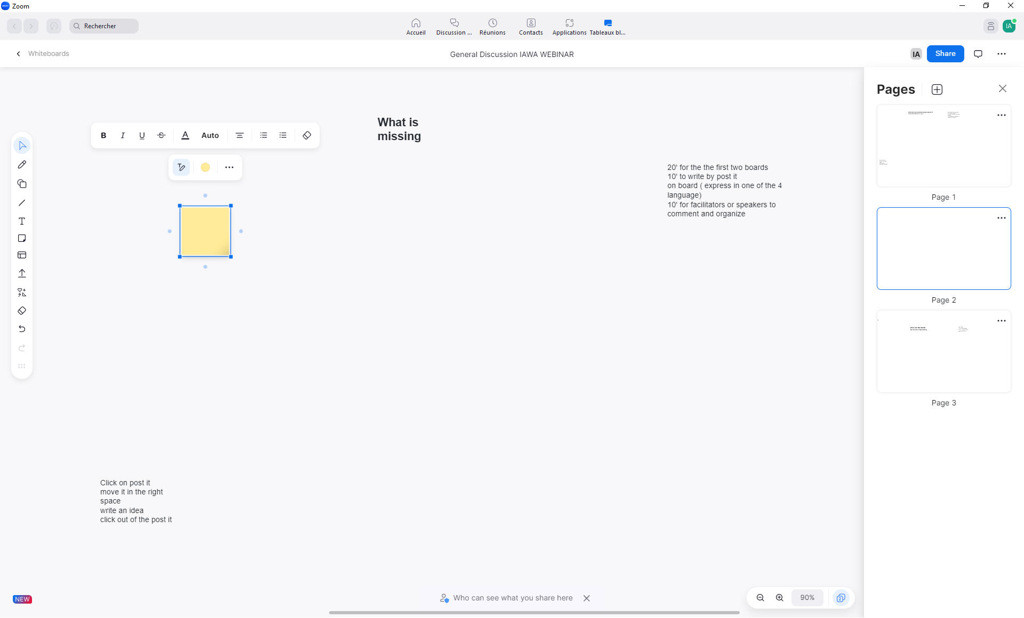
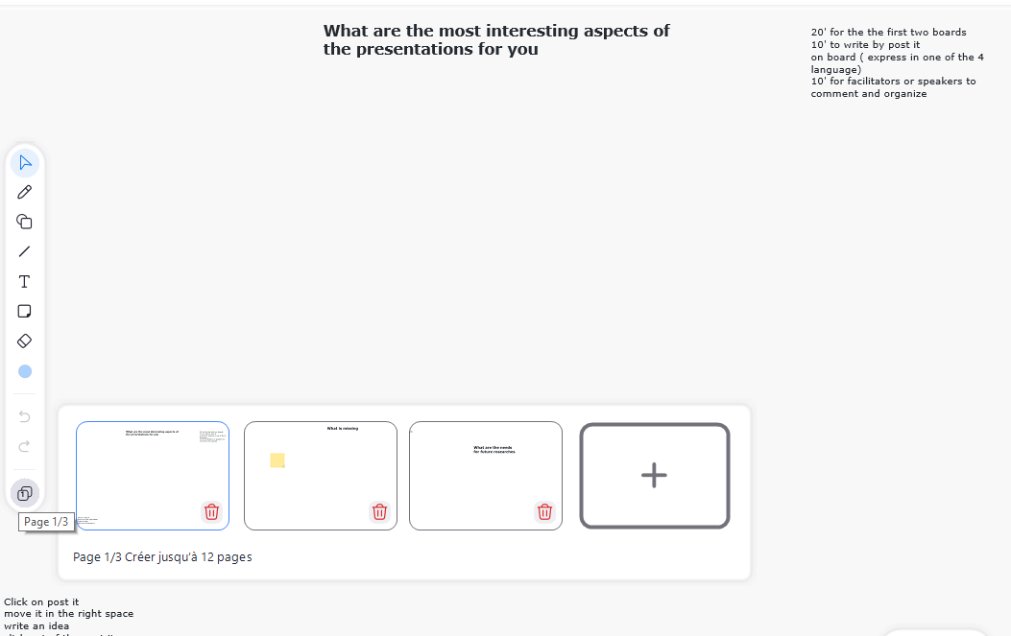
Click on post-it
Move it
on the board
Write an idea in fr or Br or Sp
or GB
And click out of the post it
The first 20’ you can come and go between the first two boards
Choose the board
What are the most interesting aspects of the presentation for you
What is missing
Click here

